Slide 1
Time Series Analysis with SAS® and R
Samuel T. Croker

Slide 2
General Ideas
R for Time series analysis when…
SAS/ETS® is not available
Time series techniques are needed that SAS/ETS does not handle (fractional differencing, wavelet decomposition, etc…)
Exploratory data analysis
Probably not when…
Production environment
Large quantities of data, many time series

Slide 3
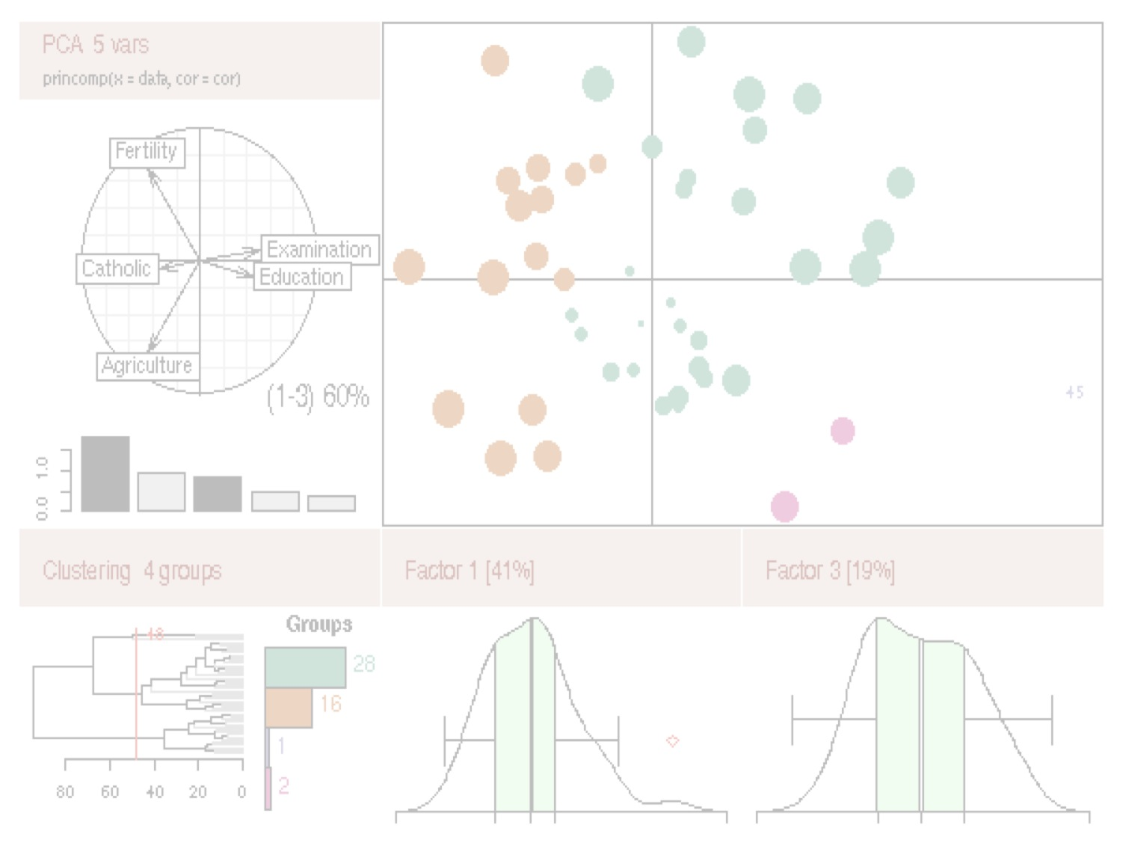
What is R?
“R is a free software environment for statistical computing and graphics.” – www.r-project.org
Powerful mathematical, statistical and graphical problem solver
Provides access to bleeding edge techniques
Relatively easy to learn
Data management and manipulation is not so easy
Free!

Slide 4
General Techniques
Use Base SAS for data preparation
Use SAS to write and call R program
Use called R program to perform the time series analysis
Return the output and results to SAS
Use SAS for final reporting

Slide 5
Folder Structure
options xwait xsync;
/* three methods: */
/* 1. Call R directly - Some errors are not reported to log */
x "'C:\Program Files\R\R-2.7.1\bin\r.exe'
--no-save --no-restore <""&rsourcepath\tsdiag.r"">
""&rsourcepath\tsdiag.out""";

Slide 6
Data Preparation with SAS
Sort, merge, transform data using SAS
Write out a text file of the prepared data
  R can read delimited files fairly easily
  Databases are also attractive… more later

Slide 7
Extracting USGS Streamflow Data
filename congtrez url ’http://waterdata.usgs.gov/nwis/uv?cb_00065=on&format=rdb&period=31&site_no=02169810’;
data congaree_trez;
infile congtrez dlm=’09’x;
length agency $10 site $10 obsdatetime 8 stage 8;
informat obsdatetime anydtdtm16.;
format obsdatetime datetime28. obsdate mmddyy10.; input agency @;
if agency ~= ’USGS’ then delete;
input site $ obsdatetime stage; obsdate=datepart(obsdatetime); obshour=hour(obsdatetime);
run;

Slide 8
Continue Data Manipulation
proc means data=congaree_trez nway noprint;
class agency site obsdate obshour;
output out=congaree_trez_hourly_avg mean(stage)=hourly_mean_stage;
run;
%let rsourcepath=c:\r_out;
data _null_;
set congaree_trez_hourly_avg;
/*write out only the hourly data for simplicity - you can make this as detailed as you want*/
file "&rsourcepath.\congaree_trez_hourly.dat";
put hourly_mean_stage;
run;

Slide 9
The R Program
library(forecast)
cong_trez <- read.table('c:\\r_out\\congaree_trez_hourly.dat')
cong_trez.ts <- ts(cong_trez)
cong_trez.fit <- arima(cong_trez.ts,order=c(1,1,0))
png(filename="c:\\r_out\\plot.png ")
tsdiag(cong_trez.fit,6)
dev.off()
cong_trez.fcst<-forecast.Arima(cong_trez.fit)
png(filename="c:\\r_out\\fcst.png ")
plot.forecast(cong_trez.fcst)
dev.off()
png(filename="c:\\r_out\\acf.png ")
acf(cong_trez.ts)
dev.off()
png(filename="c:\\r_out\\pacf.png ")
pacf(cong_trez.ts)
dev.off()
png(filename="c:\\r_out\\spect.png ")
spectrum(cong_trez.ts)
dev.off()

Slide 10
Building the R Program
data _null_;
file "&rsourcepath.\tsdiag.r";
fcst=tranwrd("&rsourcepath\fcst.png",'\','\\');
diag=tranwrd("&rsourcepath\plot.png",'\','\\');
spect=tranwrd("&rsourcepath\spect.png",'\','\\');
acf=tranwrd("&rsourcepath\acf.png",'\','\\');
pacf=tranwrd("&rsourcepath\pacf.png",'\','\\’)
put "library(forecast)";
put "cong_trez <- read.table('c:\\r_out\\congaree_trez_hourly.dat’);
put 'cong_trez.ts <- ts(cong_trez)';
put 'cong_trez.fit <- arima(cong_trez.ts,order=c(1,1,0))';

Slide 11
Building the R Program
/* redirect graphs to a png file */
put 'png(filename="' diag '")';
put 'tsdiag(cong_trez.fit,6)';
put 'dev.off()’;
put 'cong_trez.fcst<-forecast.Arima(cong_trez.fit)’;
put 'png(filename="' fcst '")';
put 'plot.forecast(cong_trez.fcst)';
put 'dev.off()’;
put 'png(filename="' acf '")';
put 'acf(cong_trez.ts)';
put 'dev.off()’;
put 'png(filename="' pacf '")';
put 'pacf(cong_trez.ts)';
put 'dev.off()’;
put 'png(filename="' spect '")';
put 'spectrum(cong_trez.ts)';
put 'dev.off()';
run;

Slide 12
Getting the Data Into R
library(forecast)
cong_trez <- read.table('c:\\r_out\\congaree_trez_hourly.dat')
cong_trez.ts <- ts(cong_trez)

Slide 13
Executing the R Program
options xwait xsync;
x "'C:\Program Files\R\R-2.7.1\bin\r.exe'
--no-save --no-restore <""&rsourcepath\tsdiag.r"">
""&rsourcepath\tsdiag.out""";

Slide 14
Including the R Log in the SAS Log
data _null_;
infile "&rsourcepath\tsdiag.out";
file log;
input;
put 'R LOG: ' _infile_;
run;

Slide 15
Getting the R Results in the SAS Output
ods html;
data _null_;
file print;
put "<IMG SRC='" "&rsourcepath\plot.png" "' border='0'>";
put "<IMG SRC='" "&rsourcepath\acf.png" "' border='0'>";
put "<IMG SRC='" "&rsourcepath\pacf.png" "' border='0'>";
put "<IMG SRC='" "&rsourcepath\spect.png" "' border='0'>";
put "<IMG SRC='" "&rsourcepath\fcst.png" "' border='0'>";
run;
ods html close;

Slide 16
Other Ideas
R RODBC package provides ODBC access to databases via SQL queries
read.csv is a read.table wrapper for CSV files

Slide 17
Questions

Slide 18
Thanks!
Sam Croker
  scoyote@scoyote.net

